Slide 1
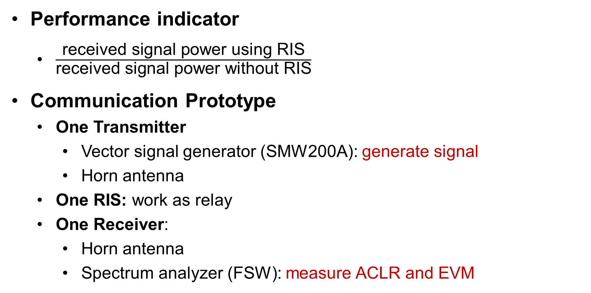
RIS-based relay
Performance indicator
$\frac{\text{received} \text{signal} \text{power} \text{using} \text{RIS}}{\text{received} \text{signal} \text{power} \text{without} \text{RIS}}$
Communication Prototype
One Transmitter
Vector signal generator (SMW200A): generate signal
Horn antenna
One RIS: work as relay
One Receiver:
Horn antenna
Spectrum analyzer (FSW): measure ACLR and EVM

Slide 2
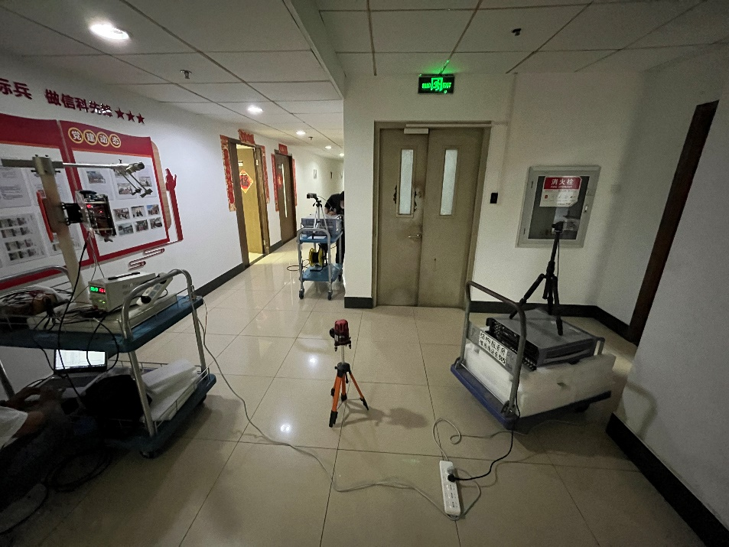
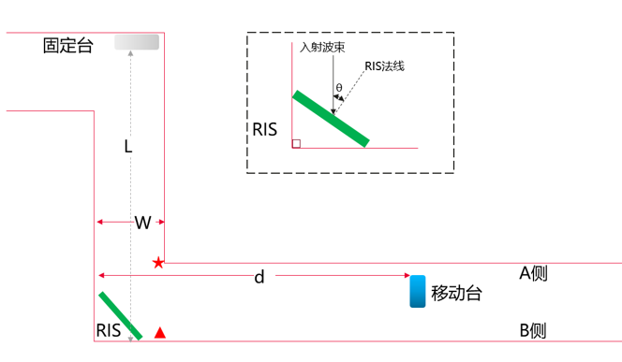


RIS-based relay
Experimental setup
L-shape corridor
Other parameters
$${30}^{∘}$$
$${60}^{∘}$$
Parameters | Value
Transmission frequency band | single-tone signal@26GHz
Transmit antenna gain | 19 dBi
Transmit power | -7 dBm
Tx-RIS distance | 0.5 m
Receive antenna gain | 18 dBi

Slide 3
RIS-based relay
Experimental results
Fig. 1 Received signal power gain vs. RIS-Rx distance, with Rx located at A
Fig. 2 Received signal power gain vs. RIS-Rx distance, with Rx located at B
Conclusion: the RIS-enabled relay can always improve the received signal strength despite the location of the receiver.

